Slide 1
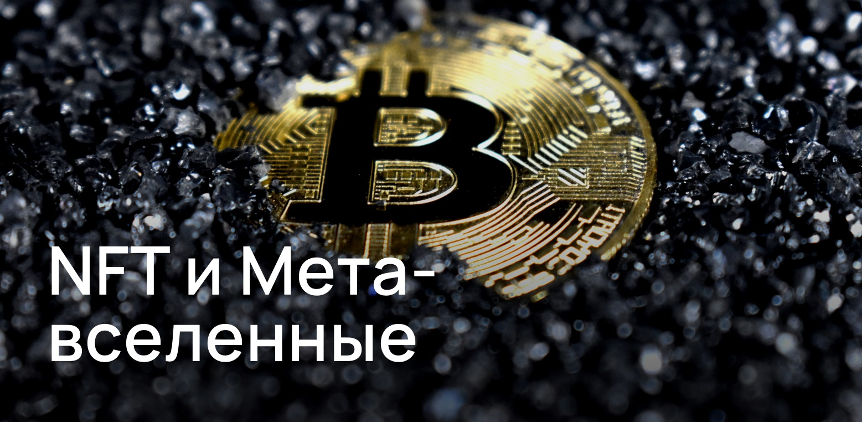
By Zhuravlev N.V., Mudrichenko M.N.

Slide 2
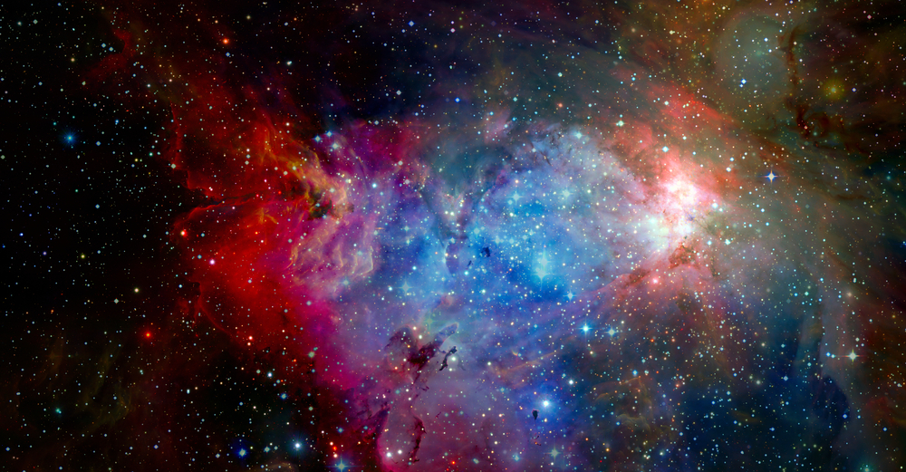
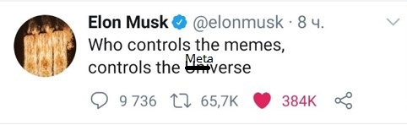
Metaverse
Imagine that there is a world in which avatars of people interact with each other and are completely controlled by people from our world!

Slide 3
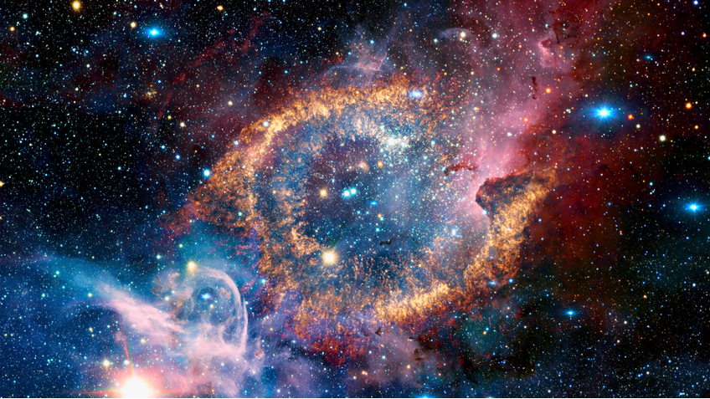
NFT (non-fungible token)
Free money
- Analogue of private property in reality
- This is an important thing in the metaverse

Slide 4
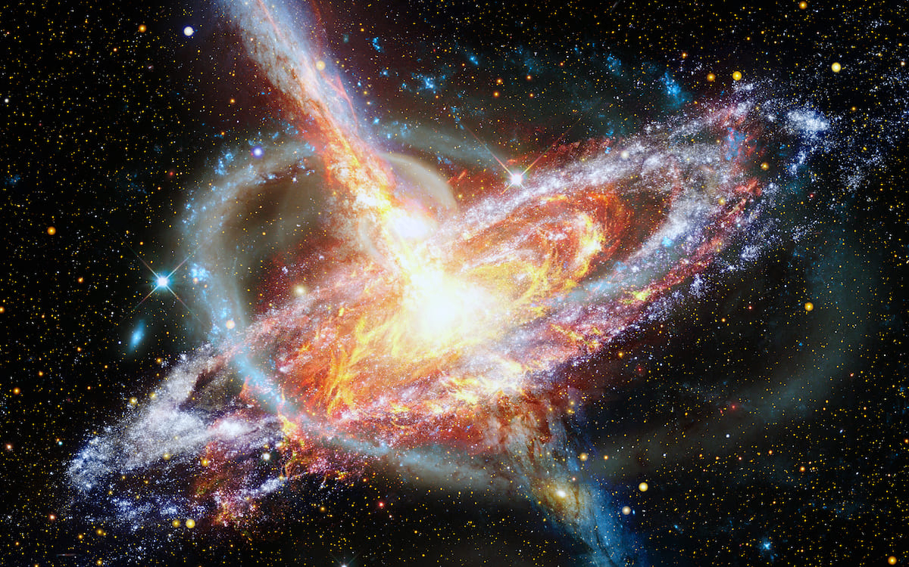
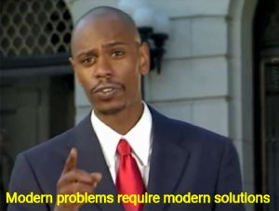
Problems of the Metaverse
TODO: Make a joke about the problem
- Absence contacted the rest of the metaverses
- Virtual world transformation

Slide 5
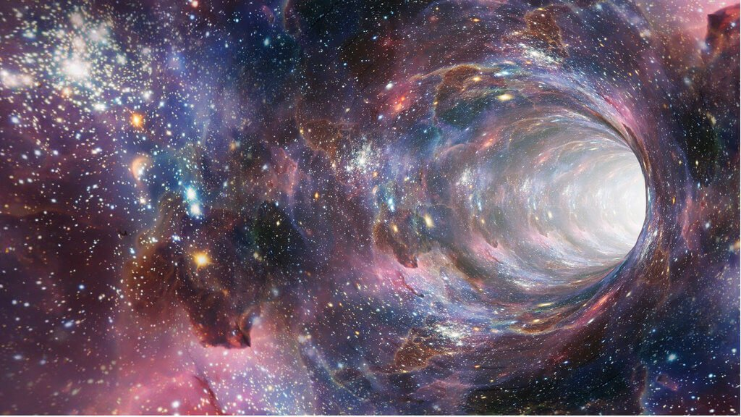
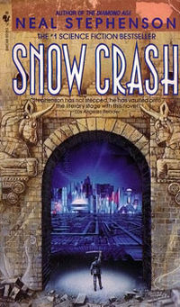
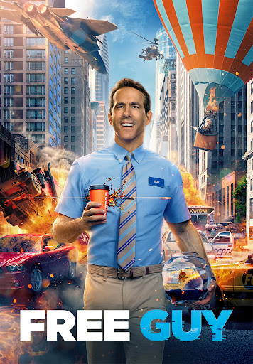
Metaverse in art

Slide 6
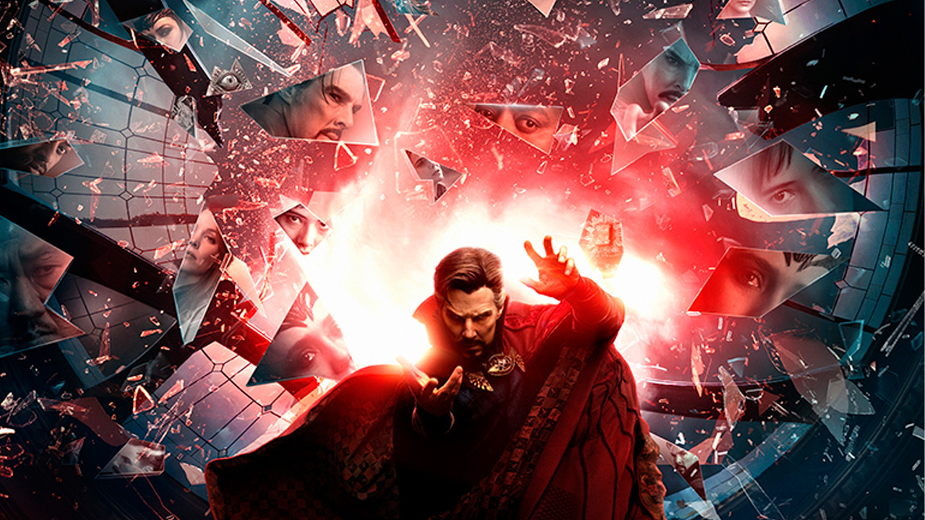
Conclusion
Metaverse is the future

